Slide 1
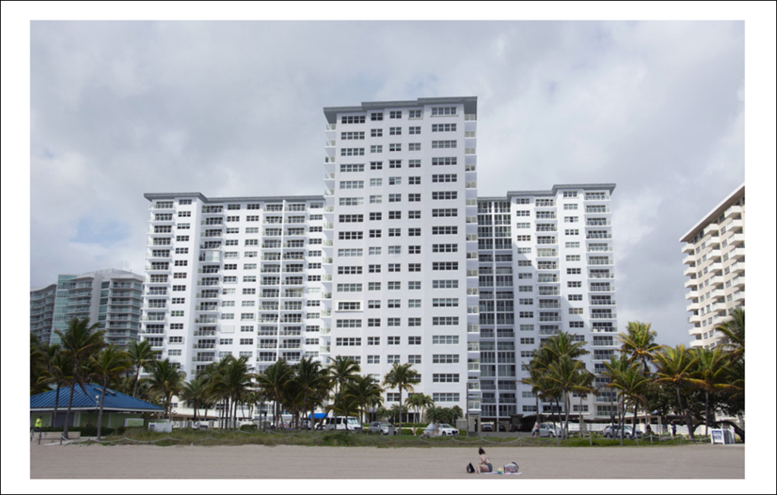
Sea Monarch Board Meeting
August 6, 2025

Slide 2
Sea Monarch Board Meeting – August 6, 2025
Agenda
Call To Order
Roll Call
Proof Of Notice
Establish Quorum
Approve Meeting Minutes
Vote On Carport Roof Painting
Vote On Pool Fence Painting
Vote On RobMar Change Order 30
Vote To Accept the Investment Committee Recommendations
Review / Accept the Audit and Finance Committee Recommendations on New Audit Firm
Vote To Accept the Design Committee Recommendations on Window Tinting
Open Discussion
Adjournment

Slide 3
Sea Monarch Board Meeting – August 6, 2025
Meeting Minutes - Approval
Motion to Approve Minutes from BOD Meeting – 7/21/2025
Board Questions / Comments
Member Questions / Comments

Slide 4
Sea Monarch Board Meeting – August 8, 2025
Carport Roof Change Order
RobMar Change Order to Re-Paint North Car Port Roof
  North Car Port Roof Needs to be Re-Painted due to Debris / Damage from Ocean Monarch Concrete Restoration.
  Efforts Have Been Made to Recover from Contractor and Ocean Monarch Board.
  Motion to Approve Change Order for $3,850
  Board Questions and Comments
  Owner Questions and Comments

Slide 5
Sea Monarch Board Meeting – August 8, 2025
Painting Pool Fence
RobMar Change Order to Paint Sun Deck Fence
Painting Sun Deck Fence Was Not Included in the Original RobMar Proposal.
Sea Monarch Requested Quote
Evaluated Options including Cable Fence and Glass Fence to Match Balconies.
Motion to Approve RobMar Change Order / Proposal for $6,500 to Prepare Paint Sun Deck Railing White.
Board Comments
Owner Comments

Slide 6
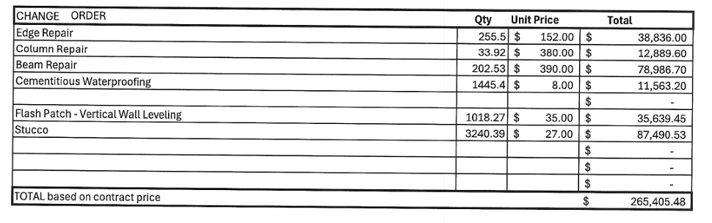
Sea Monarch Board Meeting – August 8, 2025
RobMar Change Order 30
RobMar Change Order 30 for Material Overages
Sea Monarch is Contractually Bound to Pay for these Overages as the Estimated Quantities are in the Original Contract
Motion to Approve RobMar Change Order #30 for $265,405.48
Board Questions / Comments
Owner Questions / Comments

Slide 7
Sea Monarch Board Meeting – August 8, 2025
Investment Committee Recommendations
Sea Monarch Investment Committee Recommendation
We currently earn 1.6% in all our "sweep" accounts. Our checking accounts maintain a $2,500 balance only, and the remainder is swept daily (into or out of) a FDIC insured account with multiple short-term investments. These accounts are totally liquid.
Valley Bank, has offered to set the Sweep account interest rate at 3% on all accounts (not just reserves)
We recommend accepting the 3% rate from Valley
Valley also offers CDARS program - an FDIC insured program, allowing invest in multiple separate CD's. We recommend earmarking $500,000 of the Reserves for 6 month CD’s currently earning 3.85. With $1.3 mil total in Reserves, this would leave $800,000 in the Sweep account for liquidity.
Motion to Approve Investment Committee Recommendation
Board Comments and Questions
Owner Comments and Questions

Slide 8
Sea Monarch Board Meeting – August 8, 2025
Audit and Finance Committee Recommendation
Audit and Finance Committee Recommendation - New Audit Firm
Sent Requests to 6 Audit Firms … 3 Responded
Gladstone: $14,500
Gerstle: $16,000
Aguiar: $20,000
Audit and Finance Committee Recommends Gladstone for $14,500
Motion to Approve Audit and Finance Committee Recommendation
Board Comments and Questions
Owner Comments and Questions

Slide 9
Sea Monarch Board Meeting – August 8, 2025
Design Committee Recommendation
Design Committee Recommendation
Window Tinting Update
The Design Committee Reviewed Tint Options Available from Johnson Window Films
  Two Films Recommended by Distributor / Installer
  Design Committee Select Two Additional
  Distributor / Installer will Install Mock-up
Life-Time Warranty on Material and Workmanship
Quoted at $26, 962.65 for all Hallways and Marine Lounge
Final Recommendation – After Mockup

Slide 10
Sea Monarch Board Meeting – August 6, 2025
Other Topics
Questions / Discussion

Slide 11
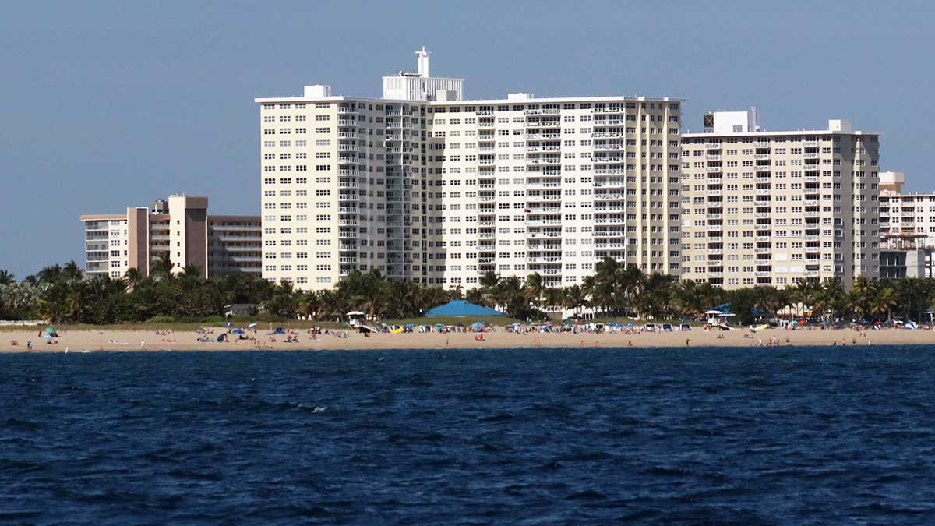
Sea Monarch Board Meeting – August 6, 2025
Adjourn

