Slide 1
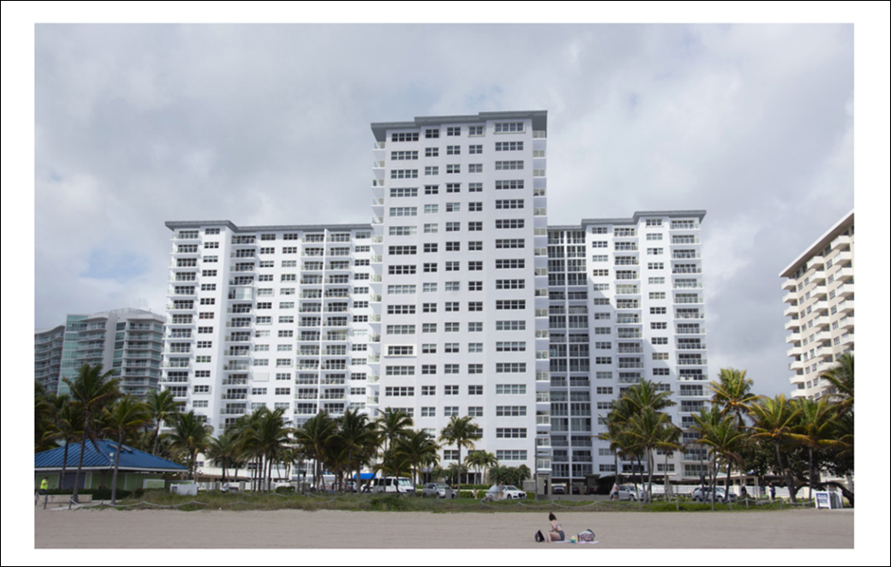
Sea Monarch Board Meeting
July 15, 2025

Slide 2
Sea Monarch Board Meeting – July 15, 2025
Agenda
Call To Order
Roll Call
Proof Of Notice
Establish Quorum
Approve Meeting Minutes
Proposed Amendment to the Declaration of Condominium
Approval to Purchase Wireless Microphones
Century Fire Annual Maintenance Quote
Installation of Sun Block Fabric at the West End of Hallways
Building Committee Update
Rights Restrictions
Open Discussion
Adjournment

Slide 3
Sea Monarch Board Meeting – July 15, 2025
Meeting Minutes - Approval
Motion to Approve Minutes from BOD Meeting – 7/7/2025
Board Questions / Comments
Member Questions / Comments

Slide 4
Sea Monarch Board Meeting – July 14, 2025
Amendment to Declaration of Condominium
New state Legislation Requires that a Majority of Voting Interest is Required to Approve Material Alteration Votes … 120 at Sea Monarch.
Unless Condominium Documents Requires Otherwise.
The Board is proposing an amendment to the Declaration of Condominium Requiring a Majority of the Quorum.
Without the change, important decisions such as carpet selection, catwalk finishes, paint and lighting could be determined by those not voting, as abstaining would count as a no vote.
Change is Needed Prior to Upcoming Material Alteration Votes.
Board Will Vote Tonight to Approve the Language of the Amendment and Owner voting will end on 8/8/2025.
This vote is important to the success and progress of phase 3 construction.

Slide 5
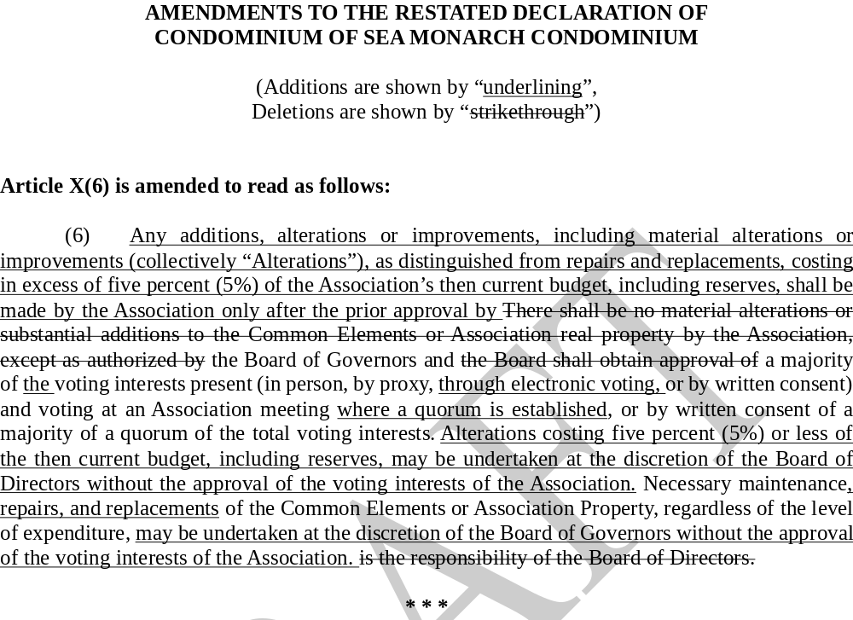
Sea Monarch Board Meeting – July 14, 2025
Amendment to Declaration of Condominium

Slide 6
Sea Monarch Board Meeting – July 14, 2025
Amendment to Declaration of Condominium
Vote to Amend Sea Monarch Declaration of Condominium.
Motion to Approve
Board Questions and Comments
Owner Questions and Comments

Slide 7
Sea Monarch BOD 7/15/2025 – Wireless Microphones
AVX Quote - $2,084
K & S = $2,597.50
Motion to Approve and Purchase AVX Solution at $2,084.
Board Questions and Comments
Owner Questions and Comments

Slide 8
Sea Monarch BOD 7/15/2025
Century Fire – Annual Maintenance Quote for Existing System
Fire Alarm Monitoring and Maintenance
Pro-Tech and AB Fire Declined to Bid
1 Year Agreement with Century
$35 / Month – Monitoring
$377/ Month – Maintenance
$0 – Quarterly Inspections
Motion to Approve Century Quote and Approval for President to Execute Agreement
Board Questions and Comments
Owner Questions and Comments

Slide 9

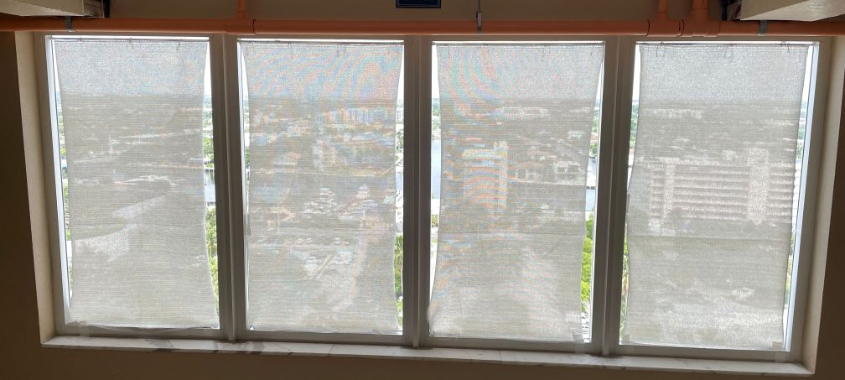
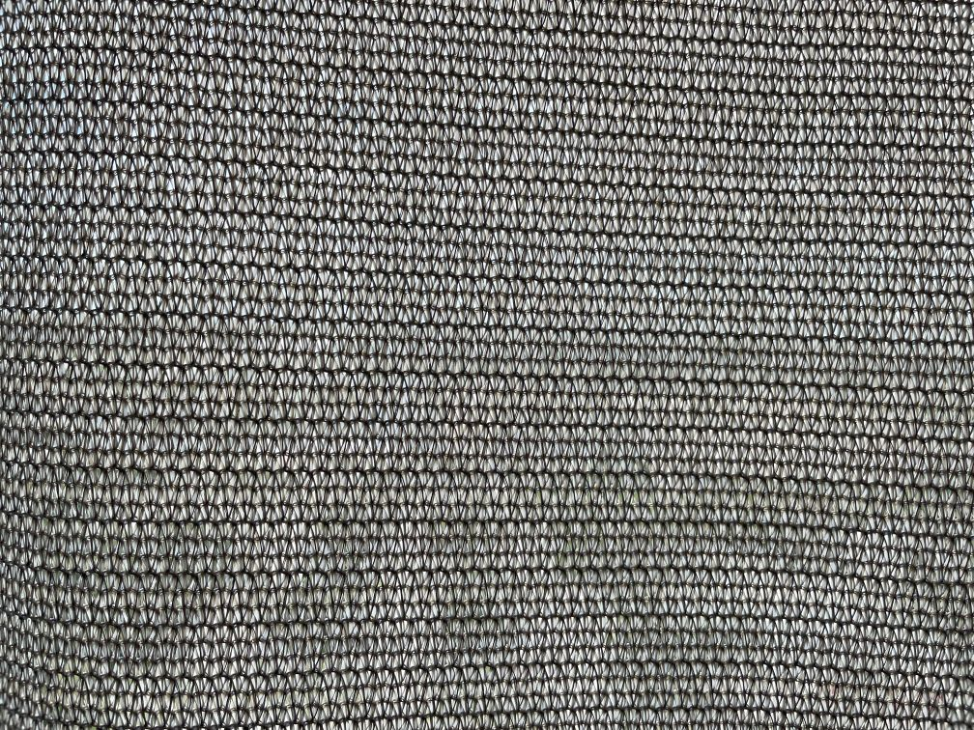
Sea Monarch BOD 7/15/2025
Installation of Sun Block Fabric
Installed on 19th Floor
Lowers Temperature
68 tension rods – 501.84
17 Rolls of Fabric - $679.66
Sales tax estimate 7% - $83
Estimated Total $1,264.50
Motion to Approve Purchase and Installation
Board Questions and Comments
Owner Questions and Comments

Slide 10
Sea Monarch BOD 7/7/2025 – Rights Restrictions
Motion to Approve Rights Restrictions on the Units Specified in the Ledger Communicated to the Board.

Slide 11
Sea Monarch BOD 7/15/2025
Building Committee Update
Meeting Held 7/10
Catwalk Finishing
  Discussed Finishing Options and Alternative Vendors
  Committee Recommends Approving the RobMar Quote using the same finish as is on the balconies with less sand.
Sprinkler Arrangement at West End of Hallways
  Great Deal of Discussion Regarding Aesthetics, Rework and Administrative Costs as well as Schedule Impact.
  Building Committee has no recommendation at this time but is exploring solutions
Drop Ceiling Recommendation
  Discussion primarily focused on cost and practicality
  Committee Recommends Not Pursuing this solution
Catwalk Entry/Exit Doors – Closing Concerns
  A Trial Door has been Scheduled

Slide 12
Stacks 1 & 14 Tiles
  Discussion Focused on Cost and Possible Water Damage
  Cost to Remove Tiles and Replace with Same Finish as Catwalks is $99,960
  Concerns Remain about Water Damage. Tiles not Permitted on Balconies or Catwalks
  Committee Recommends Moving Forward with a Material Alteration Vote
Sun Deck
  Discussion Focused on the Most Practical Solution
  Base Coat would be the Same Finish as is on the balconies
  Committee would like to Evaluate a Top “Knock Down” finish … cost and aesthetics
  Knock Down Samples to be Provided
  No Recommendation at this Time
Fire Hose Cabinets on Catwalks
  A request was made for the Committee to Evaluate Replacing Fire Hose Cabinets on the Catwalk.
Sea Monarch BOD 7/15/2025
Building Committee Update
Meeting Held 7/10

Slide 13
Sea Monarch Board Meeting – July 7, 2025
Other Topics
Questions / Discussion

Slide 14
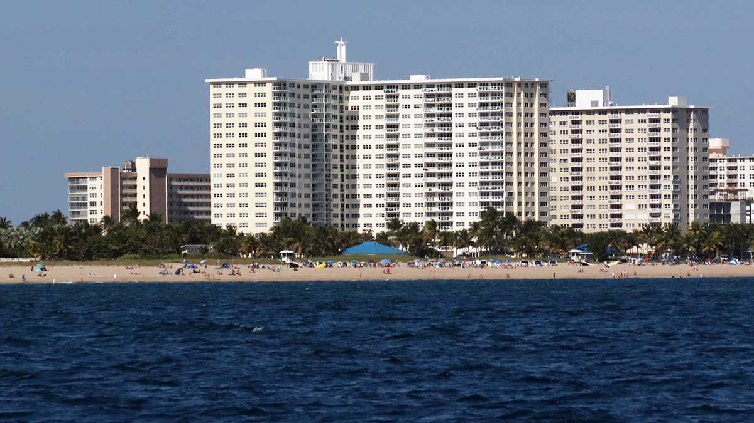
Sea Monarch Board Meeting – July 7, 2025
Adjourn

