Slide 1
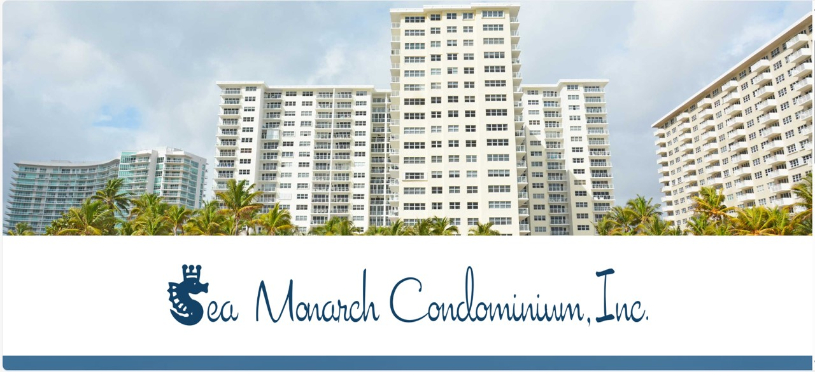
Sea Monarch Board Meeting
Tuesday May 20, 2025

Slide 2
Sea Monarch Board Meeting – Tuesday May 20, 2025
Agenda
  Call to Order
  Roll Call
  Proof of Notice
  Establish Quorum
  Meeting Minutes approval
  Mold Test Quote
  Electrical Panel Installation Quote
  Audit Committee Findings (Forensic Audit Vote)
  Sea Monarch Financial Review including Upcoming Assessment and Schedule
  Questions and Answers
  Adjourn

Slide 3
Sea Monarch Board Meeting – May 20, 2025
May 12, 2025 - Board Meeting Minutes
Motion to Approve May 12, 2025, Board Meeting Minutes
Board Comments
Association Comments

Slide 4
Sea Monarch Board Meeting – May 20, 2025
May 12, 2025 – Air Quality Experts Quote
Additional mold testing required on the concrete walls within the shafts. Quote from Air Quality Experts … our current vendor.
The Air Quality Experts team provides an indoor air quality analysis of the affected areas and areas outside of the affected areas. This includes a confined search to scope the entirety of the damage caused by a specific issue, samples with lab results, and a report listing all possible issues with universal remediation protocols.
This proposal includes a negotiated price for 3 swabs inside the air shaft, one for each concrete wall in it at $500.
Motion to Approve the Proposal from Air Quality Experts for $500.
Board Comments
Owner Comments

Slide 5
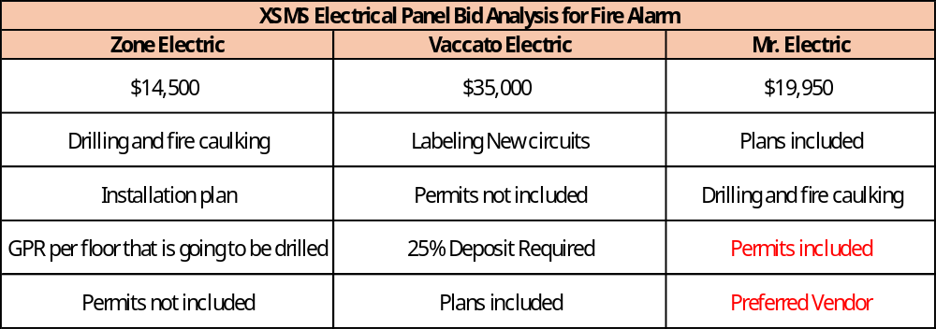
Sea Monarch Board Meeting – May 20, 2025
Electrical Panel Installation for Fire Alarm
This installation is necessary to connect the new fire alarm system to the emergency panel.
Motion to accept Mr. Electric Proposal and Approve Commencement of work
Board Questions / Comments
Owner Questions / Comments

Slide 6
Sea Monarch Board Meeting Tuesday May 20, 2025
Audit Committee Report / Recommendations
Forensic Audit
  All three firms contacted with an RFI / RFP. All three expressly recommended against conducting a forensic audit.
  In lieu of a forensic audit, the Audit Committee (3 CPAs) completed an internal audit.
  Audit Committee recommended not initiating a forensic audit at this time but reserve the right to revisit should new issues be discovered.
Identified questionable payroll transactions
  Recommended implementing a collection process to recover the amount through a two-step process if necessary (Sea Monarch request for explanation; Sea Monarch attorney request for explanation)
  The Board subsequently expanded on the Audit Committees questionable transactions.

Slide 7
Sea Monarch Board Meeting Tuesday May 20, 2025
Audit Committee Report / Recommendations
Internal Controls (unanimous conclusion – stronger controls needed
  Hiring a third-party management company (Castle Group) has already improved controls
  Controls Implemented since hiring Castle (documented on BuildingLink
    Credit card reconciliation
    Castle Click (Invoice approval process)
    Audit Committee is drafting a Sea Monarch credit card policy.
  Credit card transactions are very challenging to reconcile / validate.
    No conclusions have been reached at this time regarding credit card transactions
    No detailed receipts
    Two Board signatures on every check for credit card payments
  Subsequent meeting on Credit Card Investigation
    Focus on large / suspect transactions provided no new revelations
    Each committee member assigned 1 or 2 transactions for deep dive

Slide 8
Sea Monarch Board Meeting Tuesday May 20, 2025
Board Response to Audit Committee Report
Board met in a closed meeting with Sea Monarch attorney and followed recommendations
Continue investigation of credit card transactions as proposed by audit committee
Motion to rescind board vote for forensic audit
Board Comments
Member Comments

Slide 9
Sea Monarch Board Meeting Tuesday May 20, 2025
Financial Review Agenda
Cash Flow Projections
Interfund Receivables and Payables
Loan
Delinquencies
SIRS / Reserves
Phase Three Budgetary Estimate
Total Cost – 5 Year Projection
Assessment
Cash Flow

Slide 10
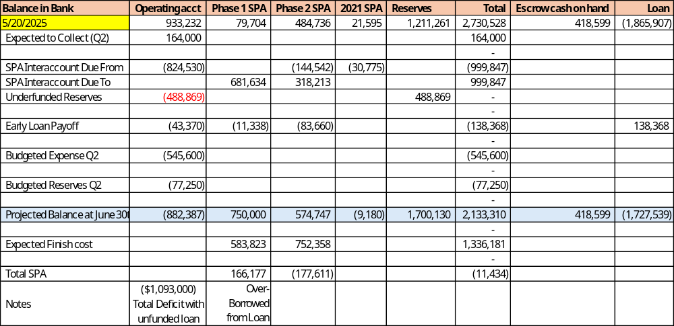
Sea Monarch Board Meeting Tuesday May 20, 2025
Cash Flow Projections

Slide 11
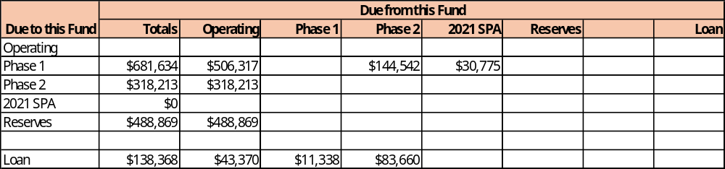
Sea Monarch Board Meeting Tuesday May 20, 2025
Interfund Payables and Receivables

Slide 12
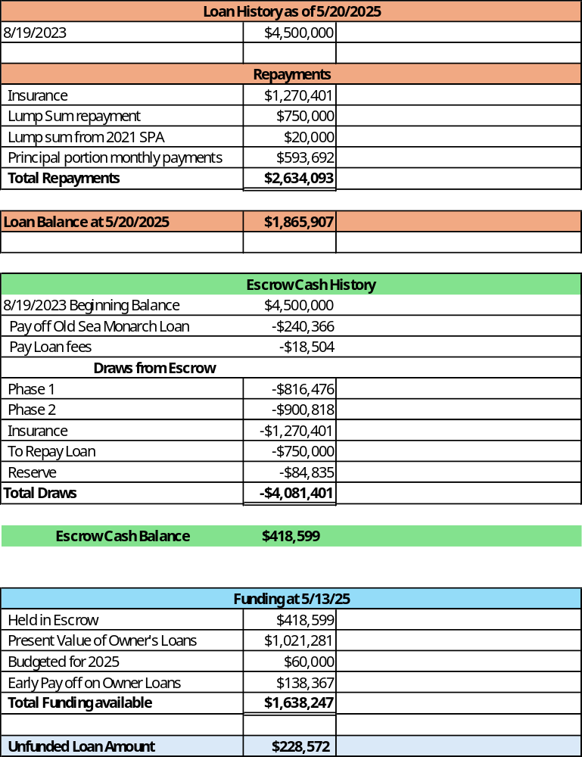
Sea Monarch Board Meeting Tuesday May 20, 2025
Loan Status

Slide 13
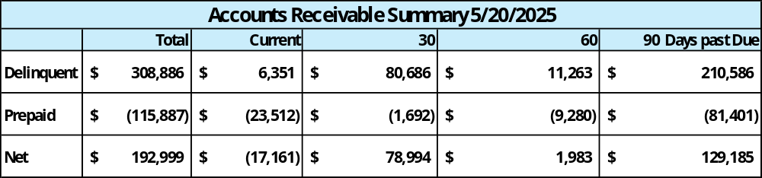
Sea Monarch Board Meeting Tuesday May 20, 2025
Delinquent Accounts

Slide 14
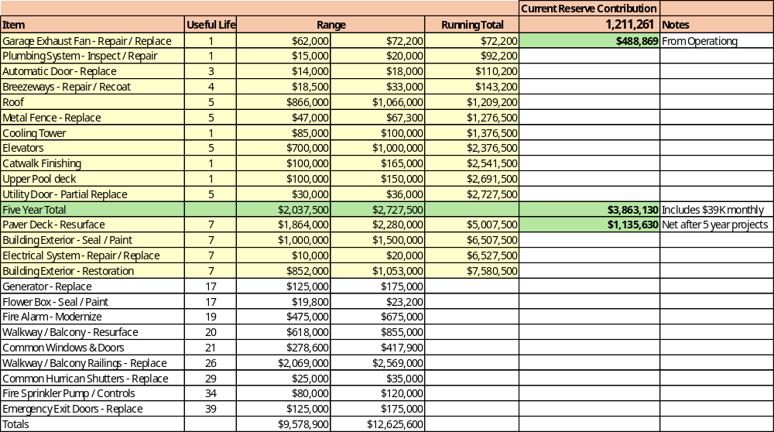
Sea Monarch Board Meeting Tuesday May 20, 2025
Reserve Expenses

Slide 15
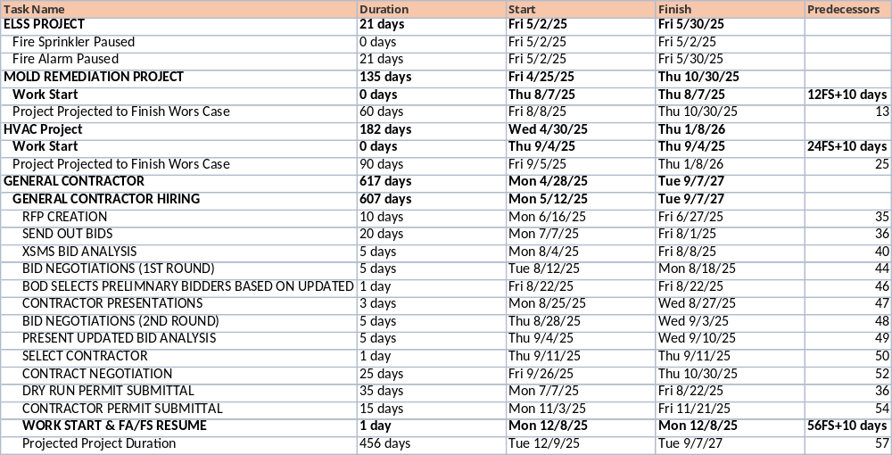
Sea Monarch Board Meeting Tuesday May 20, 2025
Phase 3 – Schedule

Slide 16
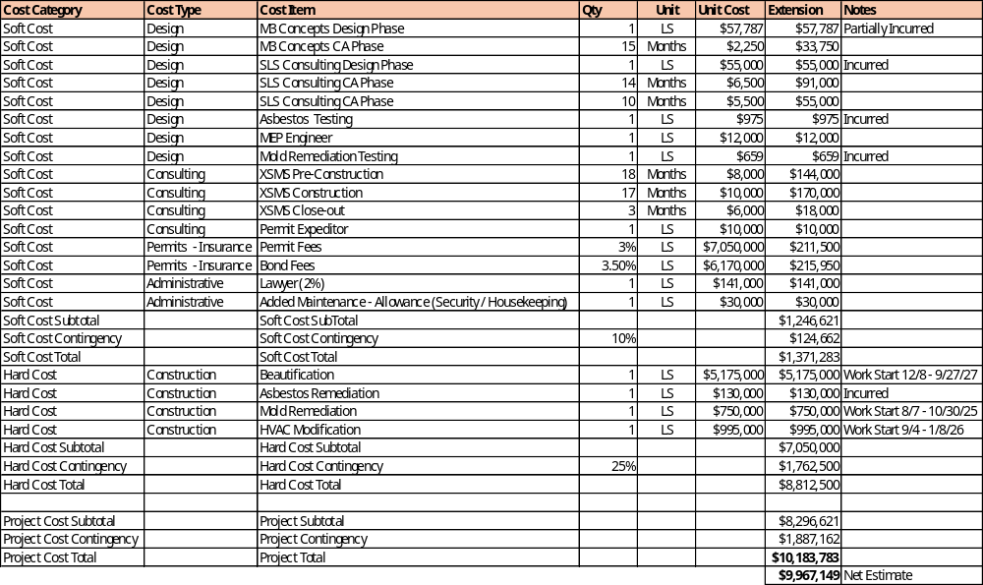
Sea Monarch Board Meeting Tuesday May 20, 2025
Phase 3 Budgetary Estimate

Slide 17
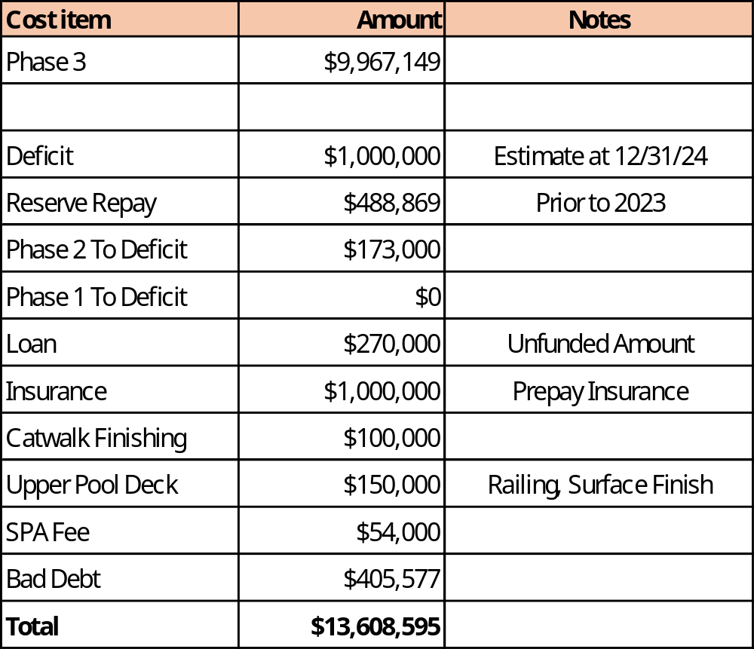
Sea Monarch Board Meeting Tuesday May 20, 2025
Total Cost – 3 year

Slide 18
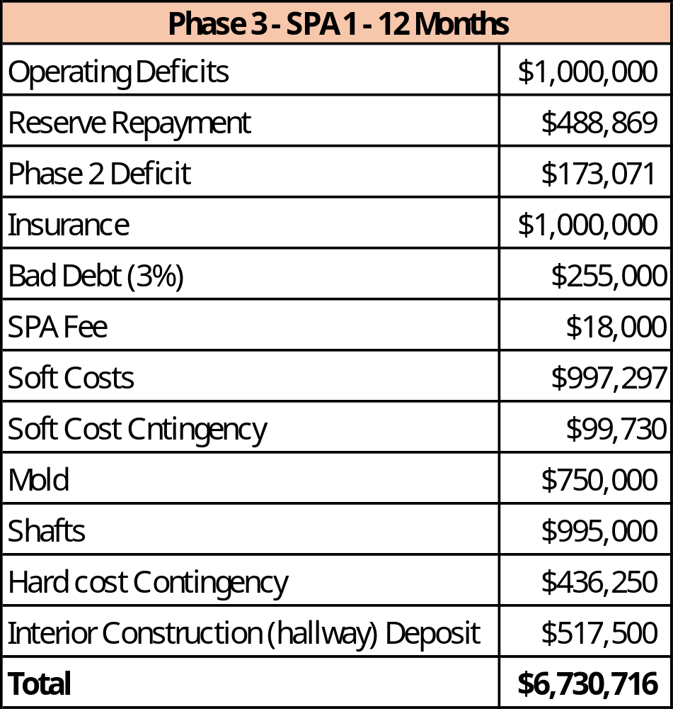
Sea Monarch Board Meeting Tuesday May 20, 2025
Phase 3 – SPA 1 - Assessment

Slide 19
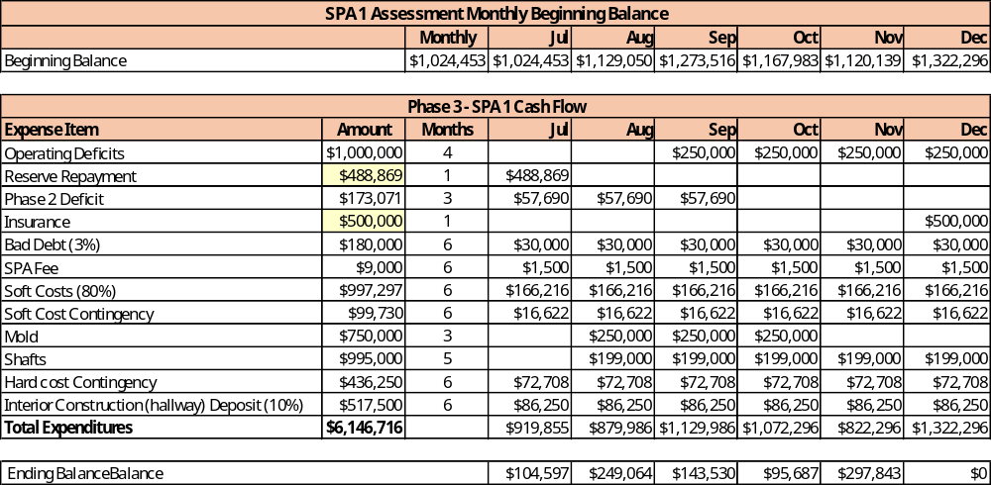
Sea Monarch Board Meeting Tuesday May 20, 2025
Project Cash Flow for Phase 3 – SPA 1

Slide 20
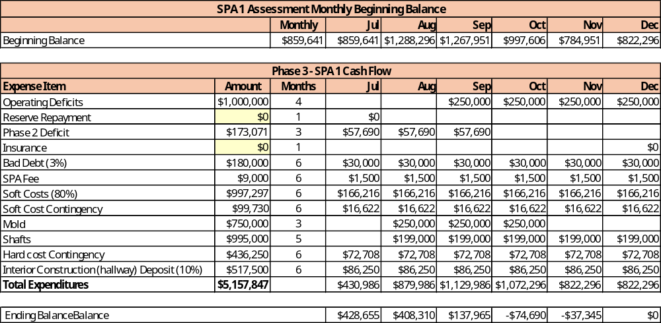
Sea Monarch Board Meeting Tuesday May 20, 2025
Project Cash Flow for Phase 3 – SPA 1

Slide 21
Sea Monarch Board Meeting Tuesday May 20, 2025
Phase 3 Assessment Assistance and Mitigations
Assistance
  3 Assessments
  Establish Monthly Payment Options
  Heloc Loans for Owners (line of Credit)
  Sea Monarch Line of Credit
  Strategic Delays
Mitigation Ideas
  Improve hallway walls but eliminate skim coating
  Pricing the labor separate from the material could potentially save on materials.
  Self manage mold remediation and/or HAVC, could save potentially $37,700.

Slide 22
Sea Monarch Board Meeting Tuesday May 20, 2025
Next Steps
Owner Meetings with Board Members
Additional Meetings with Bank
Town hall with Valley Bank on Heloc Loans
Castle Group Meeting Wednesday 5/21
Greater Involvement with Committees
  Design Committee
  Building Committee

