Slide 1
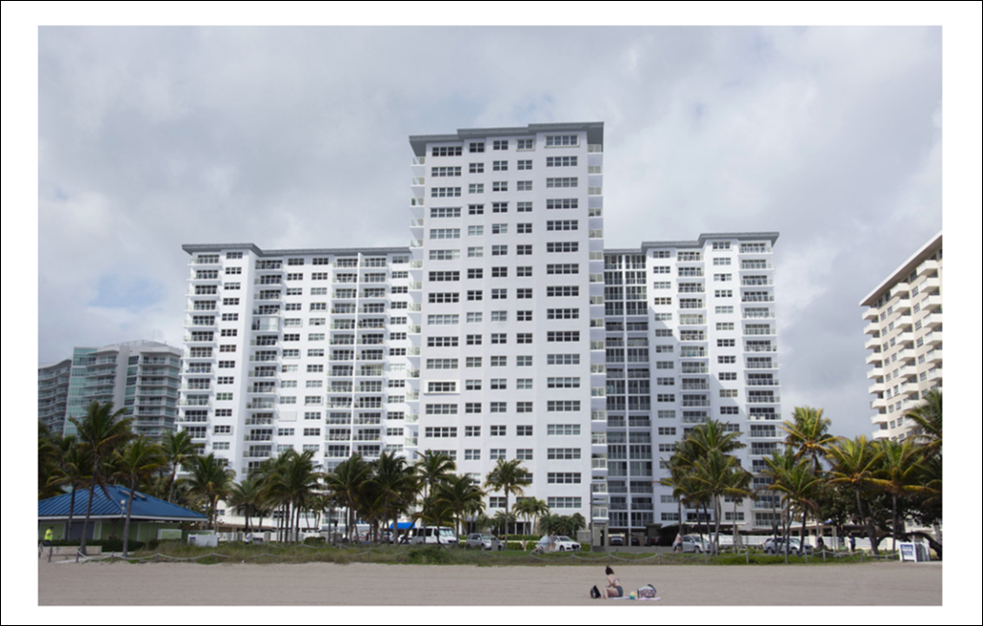
Sea Monarch Board Meeting
March 26,2025

Slide 2
Sea Monarch Board Meeting – March 26, 2025
Agenda
Call To Order / Proof Of Notice / Roll Call / Establish Quorum
Minutes from Board Meeting March 1, 2025
Treasurer’s Report
ELSS Project Updates
Penthouse and Locker rooms Remediation
  Pilot Project on PH Floor (Hallway Air Conditioning Shafts and Baseboards)
  Locker Rooms – Remediation Plan
Electrical Panel Needed for 50 Year Certificate
2023 Reserve Funding
Committees Update
Other Topics
  Sea Monarch Investment Plan
  Weight limit study for drive and outside parking
  Catwalk Waterproofing
  Rental Parking spaces
  Zoom Meeting Retention Policy

Slide 3
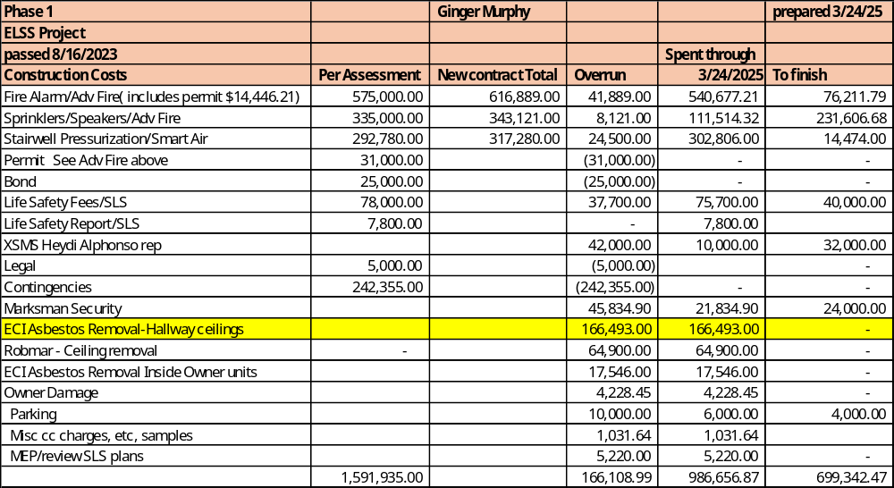
Sea Monarch Board Meeting – March 26,2025
Treasurer’s Report – Phase 1 Funding - ELSS

Slide 4
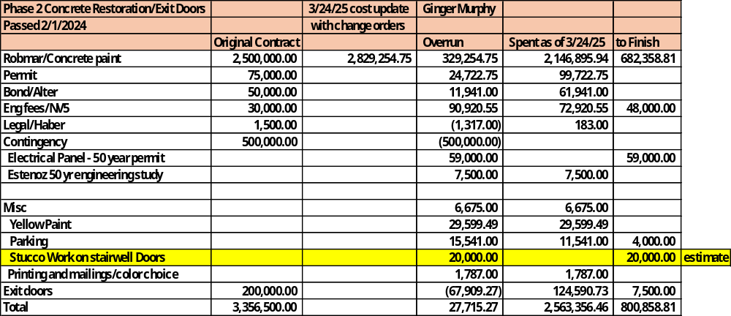
Sea Monarch Board Meeting – March 26,2025
Treasurer’s Report – Phase 2 Funding – Concrete Restoration
Motion to accept Treasurer’s Report
Board Questions and Comment
Owner Questions and Comments

Slide 5





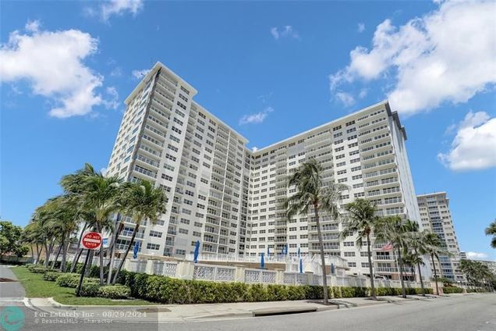

SEA MONARCH
CONDOMINIUM
Board Meeting - Project Update
March 25, 2025
Presented by
Olivia Wilson

Slide 6







FIRE SPRINKLER
Completed
-Inside Unit Sprinkler Installation PH-3
-Hallway main on central hallway PH-3
-Hallway main by the window completed until the 14th floor
-Sprinkler backbone and hallway connections completed, pending PH and 3rd
Finalize connections to run water
05/02/25
Hallway Rough Prep & Inspections
05/23/25
This Week
-Complete hallway main by the window
Complete Window Main
04/04/25
Project Pauses until GC is hired
Drop Hallway Heads
04/18/25
Inside Unit Rough Prep & Inspection
05/09/25

Slide 7





FIRE ALARM
Completed
-Run wire to the roof for elevator recall
-Fire Patch PH-3rd floor
-Stairwell main
-Kill-Off Switches for Boxes
-Stair Press fan smoke detectors and labels
-Spliced east hallways boxes PH-10
-All inside unit work on hallways and catwalks
-Pipe on catwalks
This Week
-Complete East Hallway box splices 9th-3rd
-Continue window hallway wire install
-Electrical Rough Inspection
Project Pauses until GC is hired
Troubleshooting
05/02/25
Complete Window Main
04/04/25
Beams wire
04/11/25
Rough Inspection

Slide 8


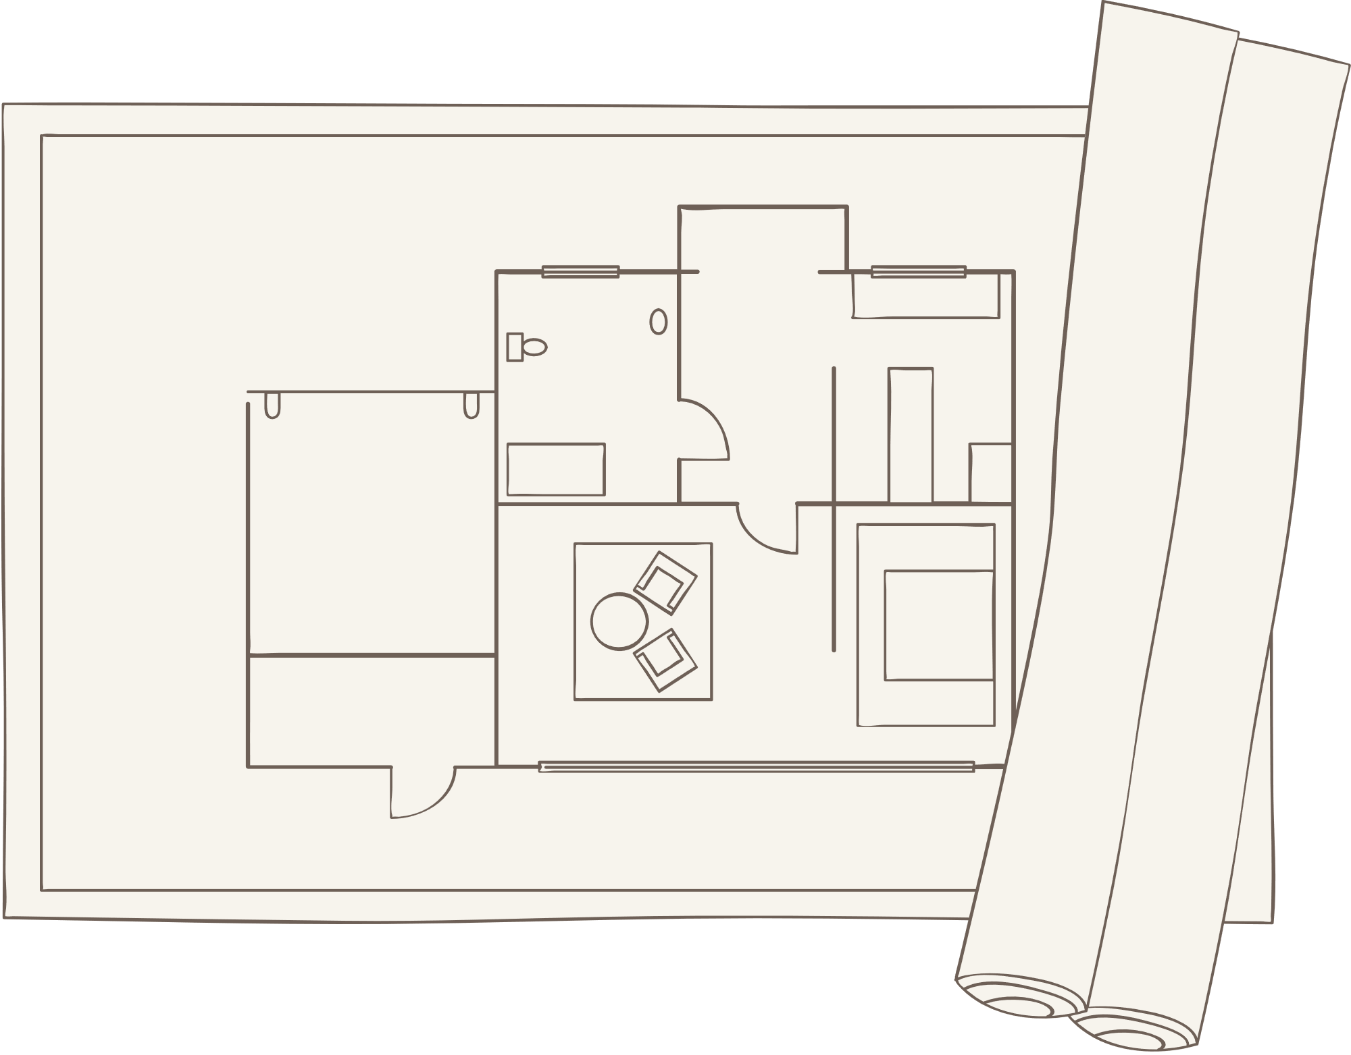
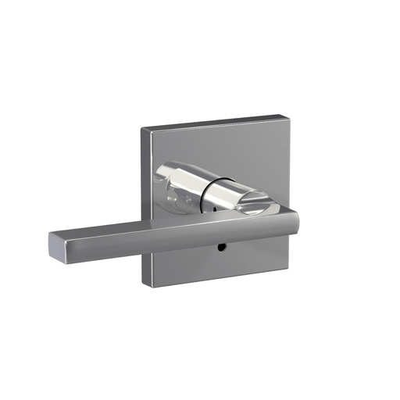

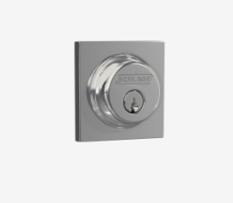
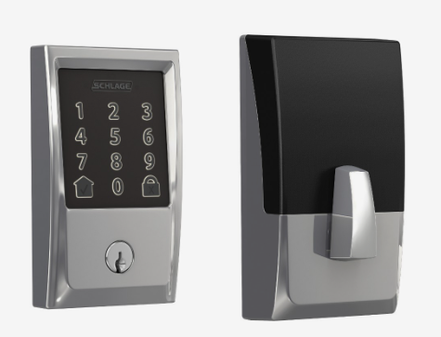

BEAUTIFICATION
-Hallway design is at 90% Completion
-Architect to provide final details for final renderings
New Renderings will be Available once the Carpet Selection is Complete

Slide 9
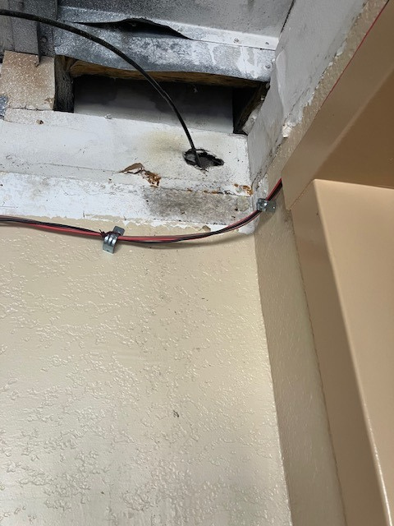

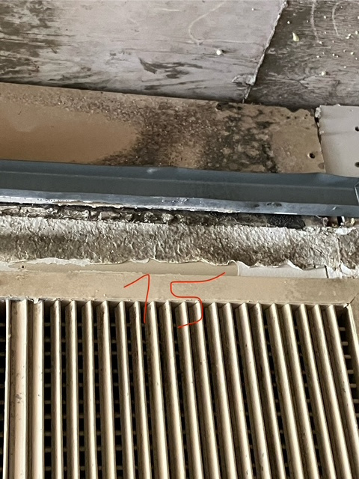
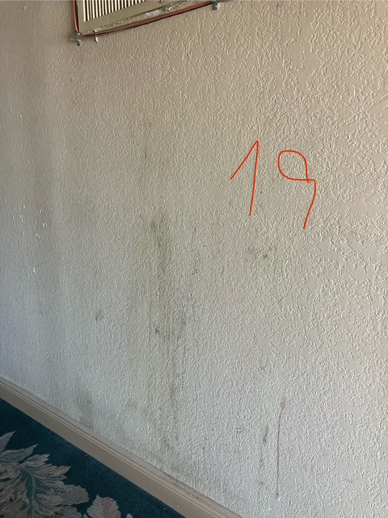

MOLD REMEDIATION
  Mold test completed
  Mold has been found in all tested locations
  Testing recap
  Plan to Move Forward

Slide 10
PROJECT OVERALL POTENTIAL TIMELINE
Mold Remediation Starts | MEP Drawings Completed
05/19.25
GC Phases
Phase 1
  Demo of existing framing & carpet
  Ceilings in the hallways only
Phase 2
  Wall reconstruction and scarifying
  Lighting
Phase 3 (After Fire Alarm Demolition)
  Paint and finishes
  Flooring
Mold Remediation | Mechanical Contractor Work
07/21/25
Fire Alarm/Fire Sprinkler Paused
05/30/25
GC to start in Phases
08/22/25
Mold Remediation Exploration Starts |MEP Selection
04/14/25
Mechanical Biding | GC Bid
05/30/25

Slide 11



THANK
YOU

Slide 12
Sea Monarch Board Meeting – March 26,2025
Vote to Approve Pilot Project on PH for Mold Remediation - Sean
Pilot Project Proposal from Environmental Control Industries (ECI)
  Scope of Work:
    Install necessary containments.
    Install HEPA Air Filtration Devices and dehumidifiers as necessary.
    Area Containments to remain erect until visual or air clearances have been obtained.
    Provide Post Remediation Completion Letter.
    Remediation to be completed in Approx. FOUR (4) business days.
  Penthouse:
    Seal vents within the work area.
    Remove and dispose of sheetrock from HVAC/Shaft vents. 2-Vents/Shafts
    Remove and dispose of baseboards. +/- 350 Lin Ft.
    Inspect for additional microbial growth.
    Apply antimicrobial solution to affected areas.
  Notes:
    Containments to be removed at the end of the shift end openings sealed with poly.
    Locker rooms or mold remediation on other floors is not included in this price.
  Price - $6,856.00
  Additional Mold Affected Sheetrock- $28.66 per/SF
  Mobilization fee: 30% of Contract Amount.

Slide 13
Sea Monarch Board Meeting – March 26,2025
Vote to Approve Pilot Project on PH for Mold Remediation – cont.
Motion to approve ECI’ proposal to start the mold remediation pilot project on floor PH as presented in the scope of work to be paid from the operating budget.
Board Questions and Comments
Owner Questions and Comments

Slide 14
Sea Monarch Board Meeting – March 26,2025
Garage Level Locker Rooms Remediation and Access Plan - Sean
Locker Rooms will Need to be Closed While Cleaning efforts are Underway.
Locker Rooms will be available through Friday 4/4 for residents to remove any “urgent” items.
  Gloves, Masks and Chlorox Solution will be available by Monday 3/31
  To Prevent the Spread of Mold to other parts of the building and owners’ units:
    Contents must be removed from the existing packaging and cleaned with chlorine-based cleaners before leaving the locker room.
    Existing packaging must be placed in the dumpster.
Locker Rooms will be closed for about 3 - 4 weeks depending on lead-time of equipment
  Dehumidifiers and Air Scrubbers will be installed in the affected locker rooms to improve air quality determined by additional testing.
  Ozone and other treatments may be used if air quality is not improved during the three-week period.

Slide 15
Sea Monarch Board Meeting – March 26,2025
Garage Level Locker Rooms Remediation and Access Plan - Sean
Once air-quality has improved, residents will be asked to dispose of any items they no longer intend to keep.
Contents that residents intend to keep will need to be cleaned using a chlorine-based cleaner. Packaging will need to be disposed of in the dumpster.
Our plan will be reviewed by an industrial hygienist
This plan is likely to evolve, and we will keep all residents and members informed as we proceed.

Slide 16
Sea Monarch Board Meeting – March 26,2025
Electrical Panels Needed for 50 Year Certification - Craig
Code requires a dedicated panel for the generator to power ELSS systems and is needed for our 50-year certification. Our current panel is not dedicated. We are proposing two additional emergency panels and a 250-amp breaker that will allow power to other systems including water, garage door and elevators.
Proposals
  Vaccato Electric $69,000
  Mr. Electric - $58,285
Motion to approve Mr. Electric to install the Electrical Panel(s) and breaker for the purpose of meeting code requirements and obtaining 50 year certification with funds from Phase II reserves.
Board Questions and Comments
Owner Questions and Comments

Slide 17
Sea Monarch Board Meeting – March 26,2025
2023 Reserves Funds - Ginger
$255,732 Borrowed from 2023 Reserves for Operating Creating a Reserve Violation.
Offsets
  January 2024 payment of 74,716.25 to 2023 reserves from operating
  Current Balance = $181,015
  Available from Electrical Claim = $120,000
    Phase 1 funding = $84,750
    Available to offset current balance = $35,250 (leaving $145,750 )
  Insurance Refund= $294,000
Fund 2023 Reserves $145,750 from operating cash
Motion – Approve the transfer of $35K from Phase 1 cash and $145K from operating to 2023 reserves.
Board Questions and Comments
Owner Questions and Comments

Slide 18
Sea Monarch Board Meeting – March 26,2025
Committees - Sean
Guidelines
  Committees must be formed by the Board at a Board Meeting
  Each committee will have Board representation to support committee needs
  Committee Leads
    Call / Organize Meeting (Sunshine Laws Apply)
    Request Budget (if needed)
    Add or replace committee members
    Develop charter
    Make recommendations to the Board as needed
The Sea Monarch Social Group is not an official committee

Slide 19
Sea Monarch Board Meeting – March 26,2025
Committees
Rules and Documents Committee
Rosa Yaker - Lead Dave Bierman - Board Judy Richman Angie Dickenson Melissa McDonough Lina Foster (new)
Violations Committee
Bruce Bernstein – Lead Phylis Krinsky Cynthia Ferenchik (new) Terry Boyer (new)
Board members and family not permitted
Communications and Technology Committee
Lynda Lusardi – Lead (new) Dave Winter - Board Michele Silber Krish Muruga Angie Dickenson
Expanded scope to include technology
Insurance Committee
John Sullivan – Lead Dave Bierman – Board Craig Fadem – Board

Slide 20
Sea Monarch Board Meeting – March 26,2025
Committees
Audit and Finance Committee
Ginger Murphy – Lead / Board Jeff Crudele Steve Schartz Davika Muruga James Cohen Terry Boyer
Expanded scope to include Finance
1st Street Committee
Dave Bierman – Lead / Board Rosa Yaker Bill Blatt - Board
Design Committee
Jill Figueroa - Lead Merryl Bernstein Deb McDermott Casey Shiloh Mary Rubino - Board
Hallway scope expanded to Design Committee
Welcome Committee
Jill Figueroa – Lead Karen Winter All Directors (on rotation) – Board

Slide 21
Sea Monarch Board Meeting – March 26,2025
Committees
Building Committee – NEW
Craig Fadem – Lead / Board Carroll Dickenson Ralph Marchand Dick Russo Tara Christiansen Dave Winter - Board Sean McDermott – Board
Key Responsibilities of a Condominium Maintenance Committee
Oversee and prioritize as needed maintenance and repairs
Participate in the annual budgeting process
Advise as needed in the reserve fund planning and management process
Provide oversight of projects managed by the Sea Monarch Owners Rep
For work not in the scope of the Sea Monarch Owners Rep:
Award business to vendors by:
  Obtaining quotes: Getting bids or estimates from various service providers (cleaning, landscaping, repair, and renovation services) to ensure competitive pricing.
  Selecting service providers: Hiring contractors and vendors / contractors and overseeing their work to ensure that it meets standards and is completed on time.
  Monitoring performance: Periodically evaluating service providers' work to ensure consistent quality.
Ensure Compliance with Regulations and Safety Protocols
Ensure accurate Communication with Owners through the Communications Committee
Monitoring Common Areas
Planning for Enhancements, Upgrades and Renovations
Develop architectural standards such as doors, AC units, Water Heaters, etc. For use when owners are replacing, upgrading, etc.

Slide 22
Sea Monarch Board Meeting – March 26,2025
Committees
Government and Community Relations – NEW
Dave Bierman – Lead Member Volunteers??
Rotating Board Members - Situational
Motion to approve all committees and committee guidelines as presented
Board Questions and Comments
Owner Questions and Comments

Slide 23
Sea Monarch Board Meeting – March 26, 2025
Other Topics – Sea Monarch Investment Plan – Ginger
Finalizing Selection of Investment Companies
  Raymond James
  Edward Jones
  Fidelity
Instruments (no risk / insured)
  CDs
  Insured Money Markets
Ready to move as much as $500K
2024 Financial Statement by Mid-May

Slide 24
Sea Monarch Board Meeting – March 26, 2025
Other Topics - Weight Limit Study for Pavers on Lobby Level
Dave Bierman
ARTICLE XII.
Parking
At the time of the purchase of member's unit, member was irrevocably assigned the parking space bearing a designated number.
The condominium unit owner has the right to let any other unit owner use his parking space. He shall not, however, permit this parking space to be used by anyone not residing in the building with the exception that his parking space may be occupied by his guest's or employee's car.
If an owner leases his apartment, a parking space must be provided to the lessee by the owner. No owner or lessee is permitted to use guest parking.
Nothing herein shall be construed to allow a transfer or separation of the parking space bearing the designated number and the unit.
The parking area is declared to be a common expense and the expenses incident· ·to the same shall be divided among the several unit owners as are other common expenses.
Parking spaces are for passenger vehicles only and no commercial vehicles, boats, trucks,· trailers, oversized RV's or other vehicles or objects including two-wheel motor vehicles shall be placed in or around the parking ·space assigned.
Florida Motor Vehicle Law defines a truck as a motor vehicle whose primary purpose is the transportation of property or weighs in excess of 5000 pounds.

Slide 25
Sea Monarch Board Meeting – March 26, 2025
Other Topics - Weight Limit Study for Pavers on Lobby Level
Dave Bierman
320.01 Definitions, general.—As used in the Florida Statutes, except as otherwise provided, the term:
(9) “Truck” means any motor vehicle with a net vehicle weight of 5,000 pounds or less and which is designed or used principally for the carriage of goods and includes a motor vehicle to which has been added a cabinet box, a platform, a rack, or other equipment for the purpose of carrying goods other than the personal effects of the passengers.
(10) “Heavy truck” means any motor vehicle with a net vehicle weight of more than 5,000 pounds, which is registered on the basis of gross vehicle weight in accordance with s. 320.08(4), and which is designed or used for the carriage of goods or designed or equipped with a connecting device for the purpose of drawing a trailer that is attached or coupled thereto by means of such connecting device and includes any such motor vehicle to which has been added a cabinet box, a platform, a rack, or other equipment for the purpose of carrying goods other than the personal effects of the passengers.
  Motion to approve that Sea Monarch hire an engineer to determine the proper weight limit for safely driving on the pavers on the lobby level.
  Board Questions and Comments
  Owner Questions and Comments

Slide 26
Sea Monarch Board Meeting – March 26, 2025
Other Topics - Catwalk Waterproofing - Craig
Follow-up from Board Meeting requesting additional quotes.
Catwalk Waterproofing Quotes
  RobMar - $165,750
  Dolmans Development - $187,000
  CBT Builders - $186,000
  Motion to select RobMar as the contractor for Catwalk waterproofing and approve the quote of $165,720 to be paid from SIRS reserves.
  Board Questions and Comments
  Owner Questions and Comments

Slide 27
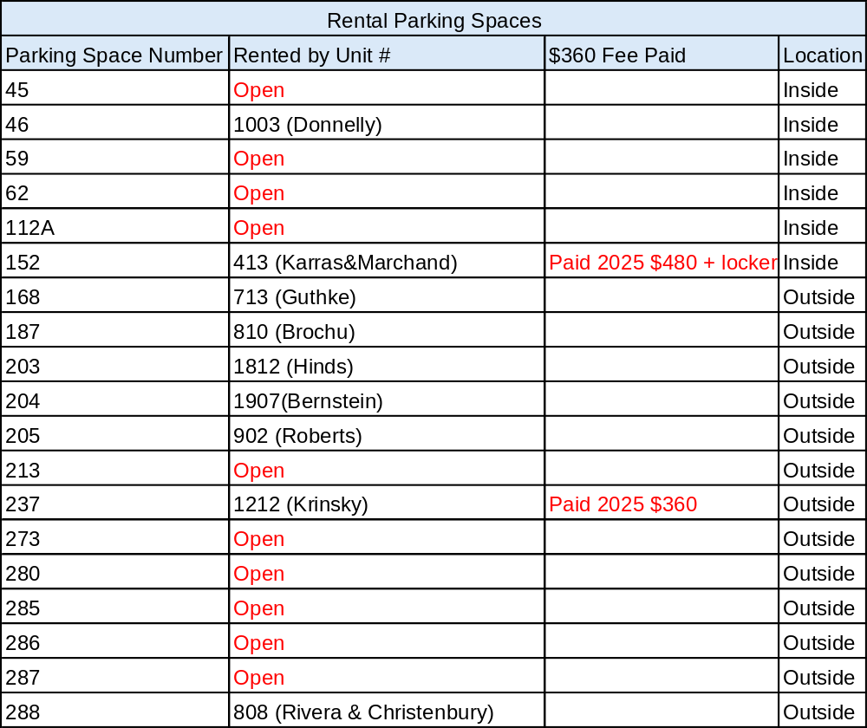
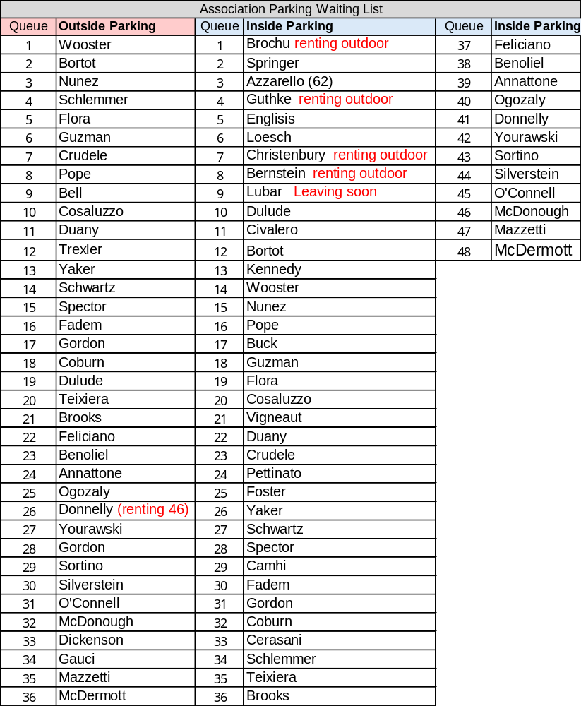
Sea Monarch Board Meeting – March 26, 2025
Other Topics - Rental Parking Spaces - Vic

Slide 28
Sea Monarch Board Meeting – March 26, 2025
Other Topics - Zoom Meeting Retention Policy
Dave Winter
  Motion to enable the auto-delete feature for Zoom recordings after 90 days
  Board Questions and Comments
  Owner Questions and Comments.

Slide 29
Sea Monarch Board Meeting – March 26,2025
Owners Questions and Comments

Slide 30
Sea Monarch Board Meeting – March 26,2025
Adjourn!!

