Slide 1
Sea Monarch
Building Committee
Thursday May 29, 2025, Meeting
4:00 PM
Marine Lounge

Slide 2
Sea Monarch – Building Committee Meeting 5/29/25
Agenda
Call To Order
Roll Call
Proof Of Notice
Establish Quorum
Review of SIRS Report Findings
Review Non-SIRS Report Findings
Review Proposals for Catwalk Finishing and Tile Removal
Review Proposal for Decorative Finish on Upper Pool Deck
Update on Utility Closet Survey
Open Discussion on Catwalk Door Locks
Catwalk Doors – Dick Russo
Sprinkler Design – Near Catwalk Doors – Dick Russo
Open Discussion
Adjourn

Slide 3
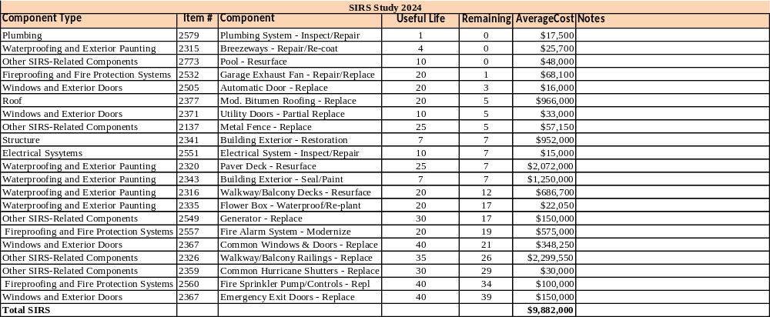
Sea Monarch – Building Committee Meeting 5/29/25
2024 Reserve Study - SIRS

Slide 4
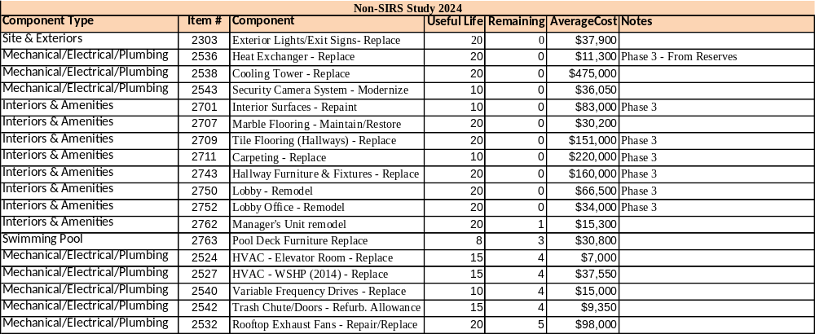
Sea Monarch – Building Committee Meeting 5/29/25
2024 Reserve Study – Non-SIRS

Slide 5
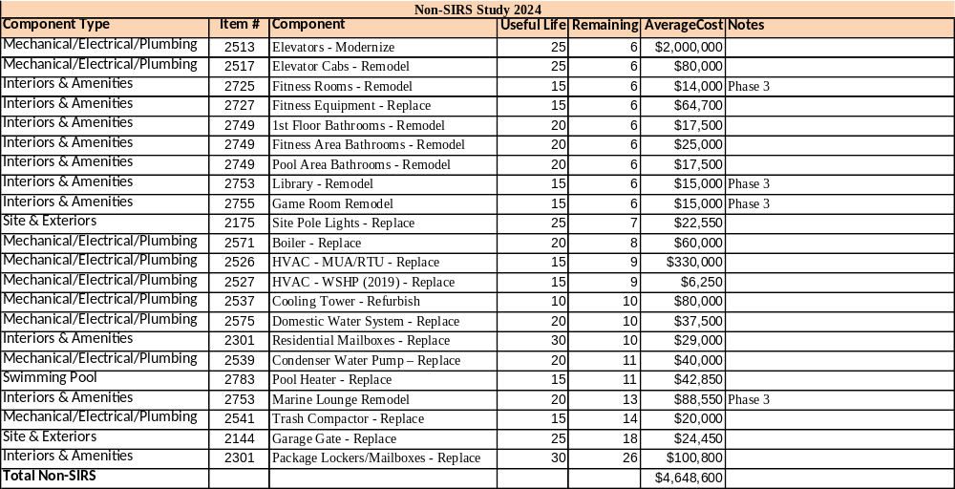
Sea Monarch – Building Committee Meeting 5/29/25
2024 Reserve Study – Non-SIRS

Slide 6
Sea Monarch – Building Committee Meeting 5/29/25
Catwalk Finish
Catwalk Waterproofing Quotes (not including Stacks 1 and 14)
  RobMar - $165,750
  Dolmans Development - $187,000
  CBT Builders - $186,000
  Splash Paint – Comparable Pricing to Advanced Surfaces (not recommended)
  Advanced Surfaces - $48,950
    Remove Tiles and Finish in Stacks 1 & 14 - $57,607 - $75,868
    Pool Deck Decorative Finish - $31,901 - $40,514

Slide 7
Sea Monarch – Building Committee Meeting 5/29/25
Catwalk Finish
  Advanced Surfaces – Catwalks
    Pressure Clean, 2 Coats Water Based Stain / Sealer with Skid Guard Additive = $48,950
  Advanced Surfaces – Stacks 1 & 14 (includes tile removal)
    Stamped Surface (URO System)
      Stone = $68,898
      Tile = $72,383
      Ashlar or Wood = $75,868
    Texture Systems
      One Color No Design = $57,697
      One Color with Design = $60,137
      Two Colors with Design = $63,970

Slide 8
Sea Monarch – Building Committee Meeting 5/29/25
Upper Pool Deck
  Advanced Surfaces
    Stamped Surface (URO System)
      Stone = $37,264
      Tile = $38,889
      Ashlar or Wood = $40,514
    Texture Systems
      One Color No Design = $31,901
      One Color with Design = $33,039
      Two Colors with Design = $34,826

Slide 9
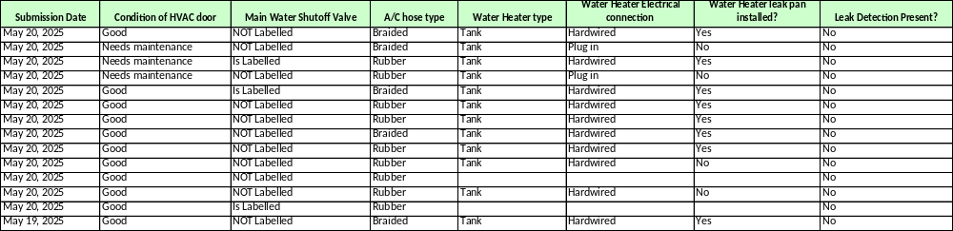
Sea Monarch – Building Committee Meeting 5/29/25
Update on Utility Closet Survey

Slide 10
Sea Monarch – Building Committee Meeting 5/29/25
Catwalk Door Hardware

Slide 11
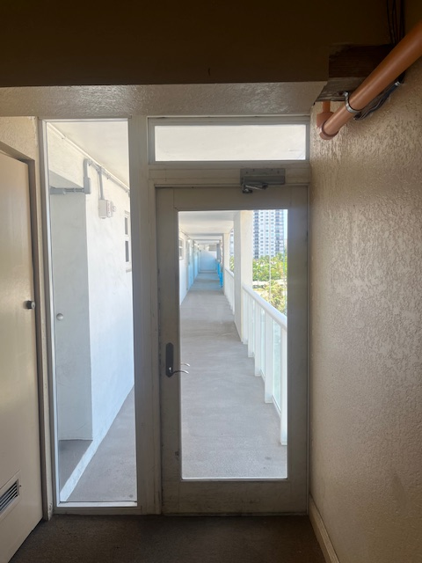
Sea Monarch – Building Committee Meeting 5/29/25
Catwalk Entrance / Exit Doors
Door Closure Concerns

Slide 12
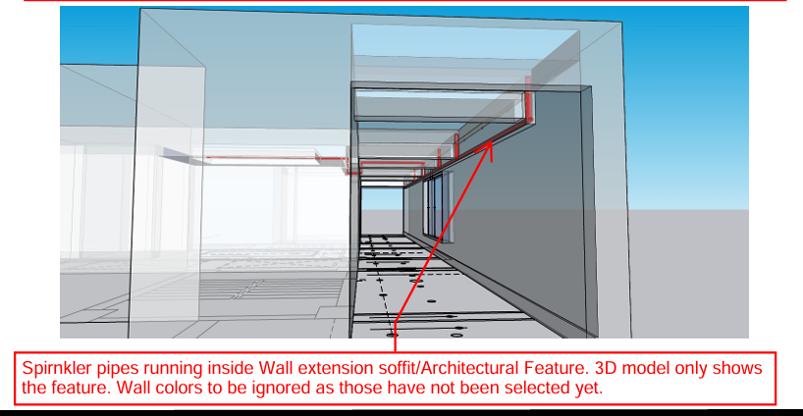
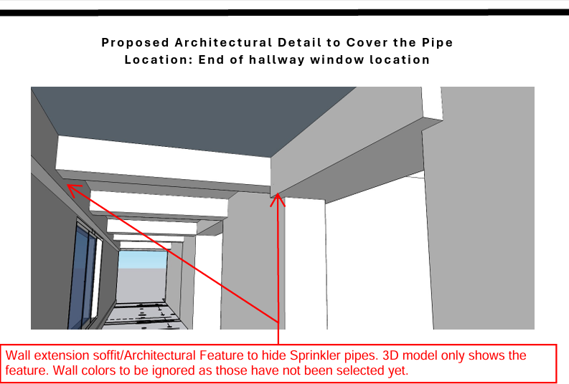
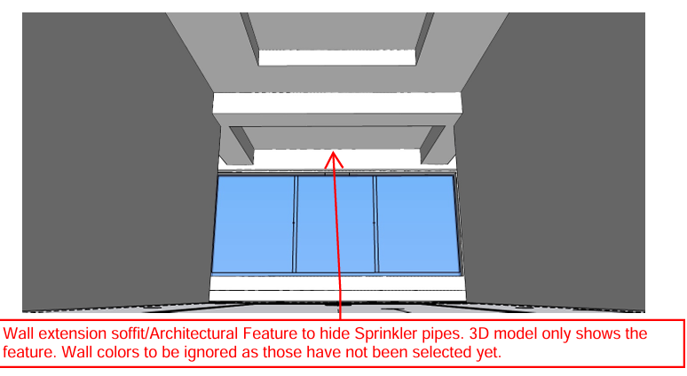
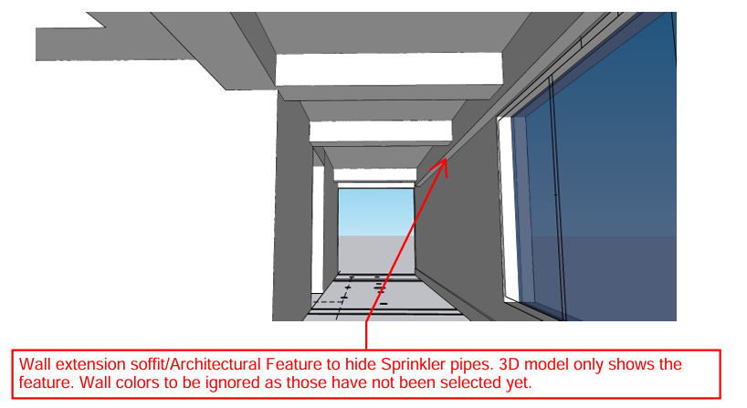
Sea Monarch – Building Committee Meeting 5/29/25
Elevator Area Sprinkler Design

